Slide 1
Expedia Hotel Recommendation
Python final project
Team 5:
Aniket W
Mohil J
Taha T
Vijay T
Yamini R

Slide 2
Overview
Introduction:
Business Problem and Importance of Solving the problem
Goals of the project
Implications of the project
Dataset:
Describing the dataset
Data Preprocessing
Facts & Visualisation
Fitting the Model
Conclusion
Annexure (Snippet of code for reference)

Slide 3
Introduction (1/2)
Business problem & What are we trying to solve:
Planning a vacation can be overwhelming
Hundreds of hotels/destination to choose
Idea of vacation is leisure and thus providing personalized hotel recommendations can be ease to the user.
Providing a better user experience, increasing customer satisfaction, and improving the overall revenue of the hotel industry.
Goals:
Primary Goal:
Build a hotel recommendation system based on users their search, booking history and preferences
Help selecting hotels that match their preferences, budget, and location
Secondary Goal:
Evaluate the performance of multiple classification algorithms
Select the best-performing model based on evaluation metrics and cross-validation results.

Slide 4

Introduction (2/2)
Implication of the project:
Customer:
Reduction of time spent on deciding.
Ease & Convenience
Hotel Industry:
Improved customer satisfaction
Increased revenue
Efficient marketing
Enhanced user experience

Slide 5
Dataset (1/8)
Describing the dataset:
Data taken from Kaggle : https://www.kaggle.com/competitions/expedia-hotel-recom
No of Rows – 37670293 & No of Columns – 24
(list of variables with description added in Annexure)
Variables:
Input variables : User location, device used, package, etc(detailed list attached in annexure)
Output variable : Hotel_cluster
Variable treatment
Using existing variables created new variable “No of days before booking” and “Stay duration”
Checked Zero variance and high cardinality in variables
Imputed missing data using Median.
Data was scaled
Dropped variables which had high cardinality, zero variance and no correlation.
After performing all pre-processing steps data was split into train and test (70:30)
Data Preprocessing
Filtered random 1L records for preprocessing and customer who did the bookings.
Converted date into months and year
Checked the data for missing values.

Slide 6
Interesting Insights (2/8)
The top 5 hotel clusters are 91,48, 42, 59, 28
81% booking is done using site_name ”2” and 94% from posa_continent “3”
90% of customers who made the booking are from country “66” and “205” and most frequent Hotel_cluster booked in country “50”
90% customers make bookings using “Device other than mobile” and 95% took the entire Holiday package
52% and 36% customers booked rooms for 2 adults and 1 adult respectively and 80% travel without kids.
Channel “9” was the most effective marketing channel.
People booking hotel for 1 night is higesh with 56% followed by 2 days with 22% and 3 days with 11%.
Graphs supporting the above are in next slides

Slide 7
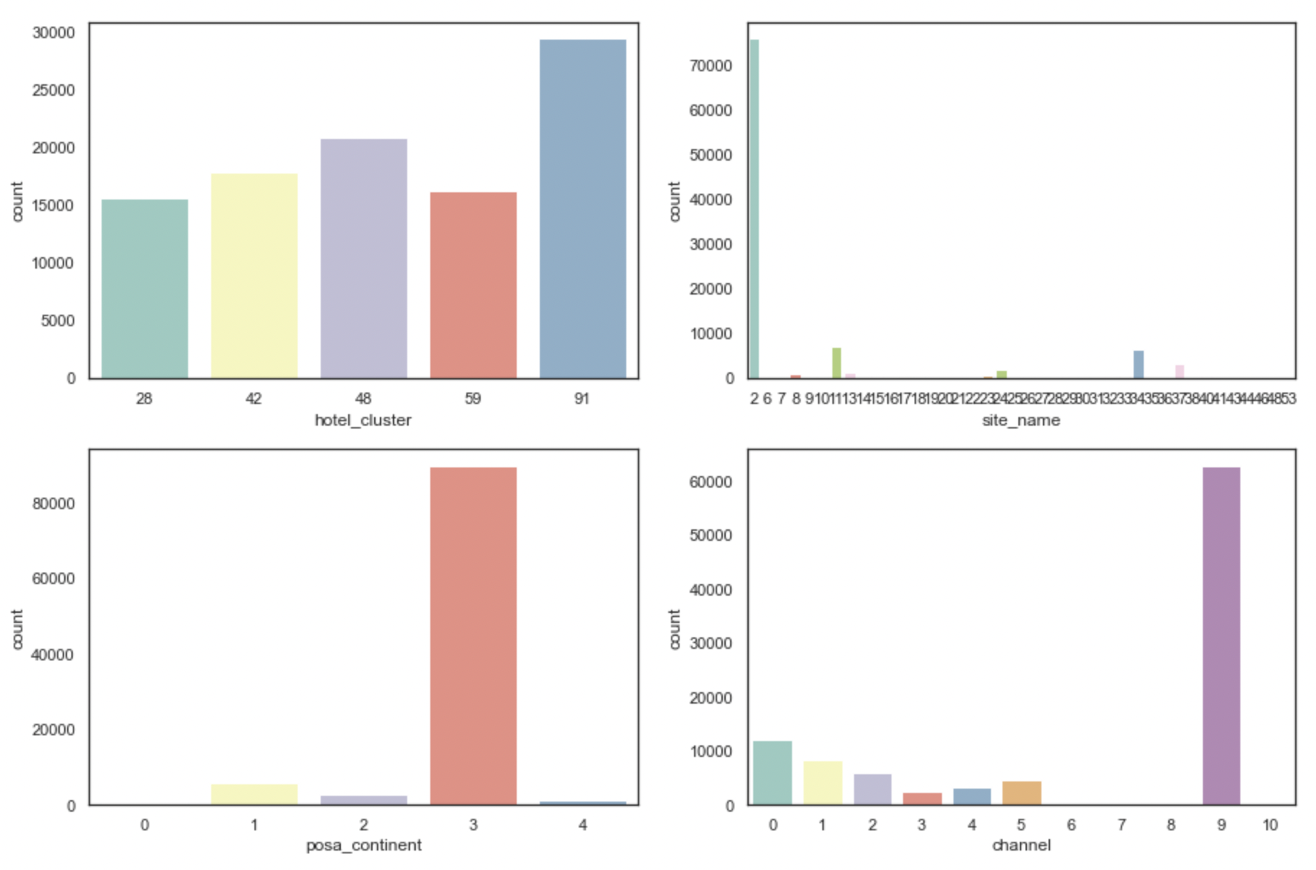
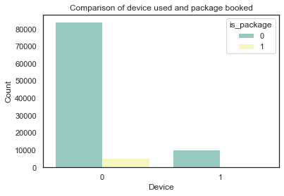
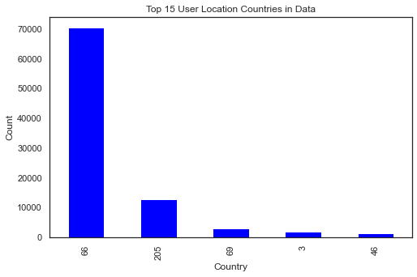
Visualisation (3/8)

Slide 8
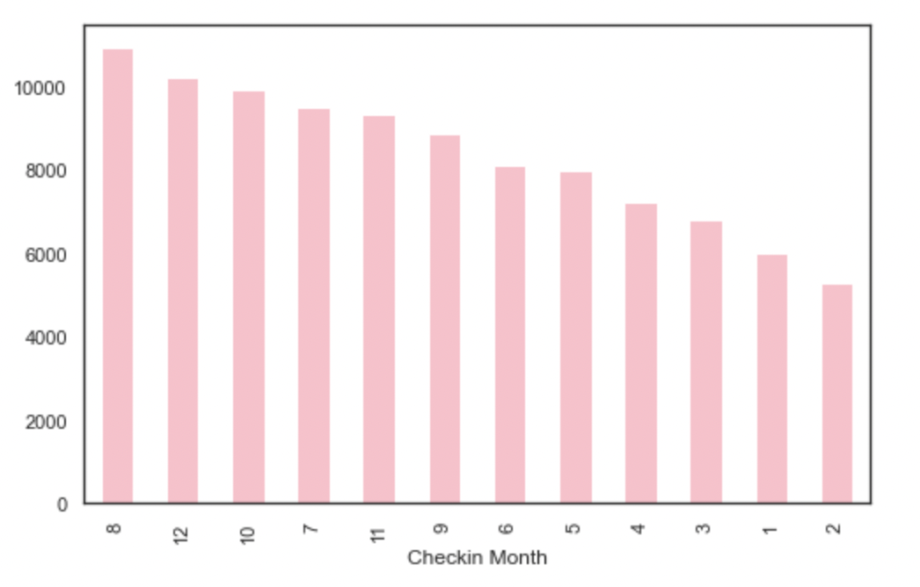
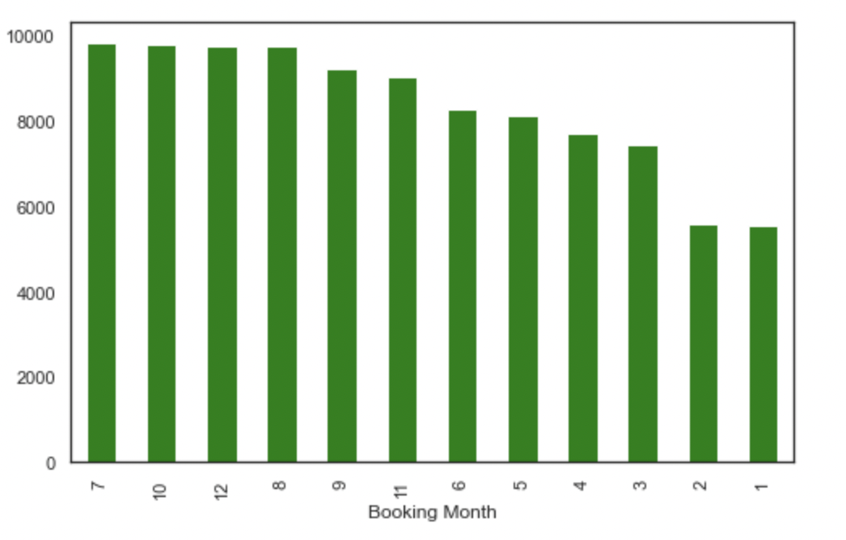
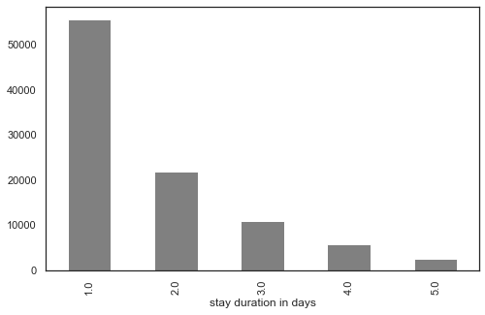
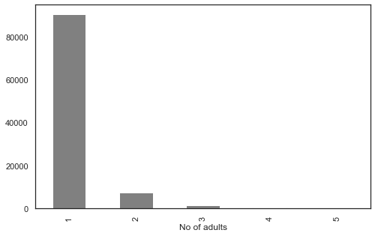
Visualisation (4/8)

Slide 9
Fitting the Model (5/8)
Steps for selection of Data & Variables:
Different combination were used to identify the best fitting variables, with scaling and without scaling of the data
Train and Test data was also split basis booking month and year i.e. 2013 and till Aug 2014 as train and beyond 2014 as test
Performed Principal component analysis for dimension reduction.
Total no of Hotel_cluster in the dataset was 30+ however using all of them did not give a good model for prediction.
Thus, for better prediction we filtered Top 10 / Top 5 clusters and built a model.
The variables have no correlation and so we did not use Linear Regression.
Models used for prediction : K-NN, logistic regression, Random Forest, Decision Tree and XG Boost.
Snippet of accuracy of various combination has been added in annexures

Slide 10
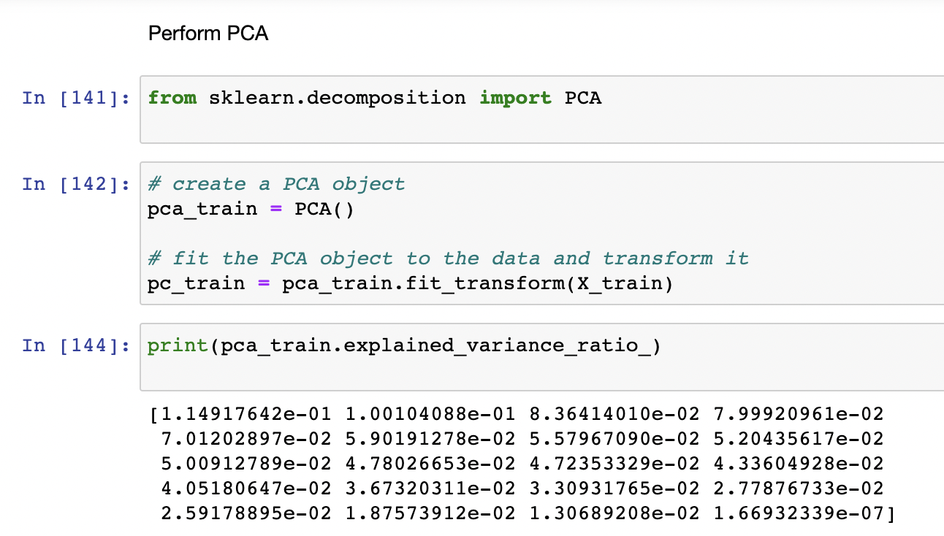
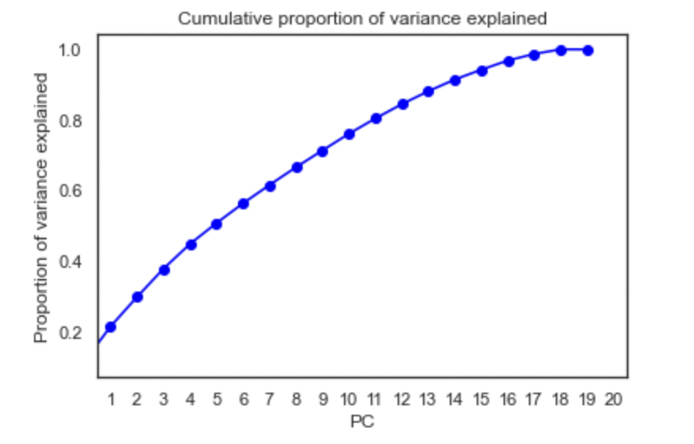
Fitting the Model – PCA (6/8)
Performed PCA for dimension reduction
90% variation was explained by variables till 15
Performance of model without PCA and scaling of data for Top 5 clusters performed better than PCA

Slide 11
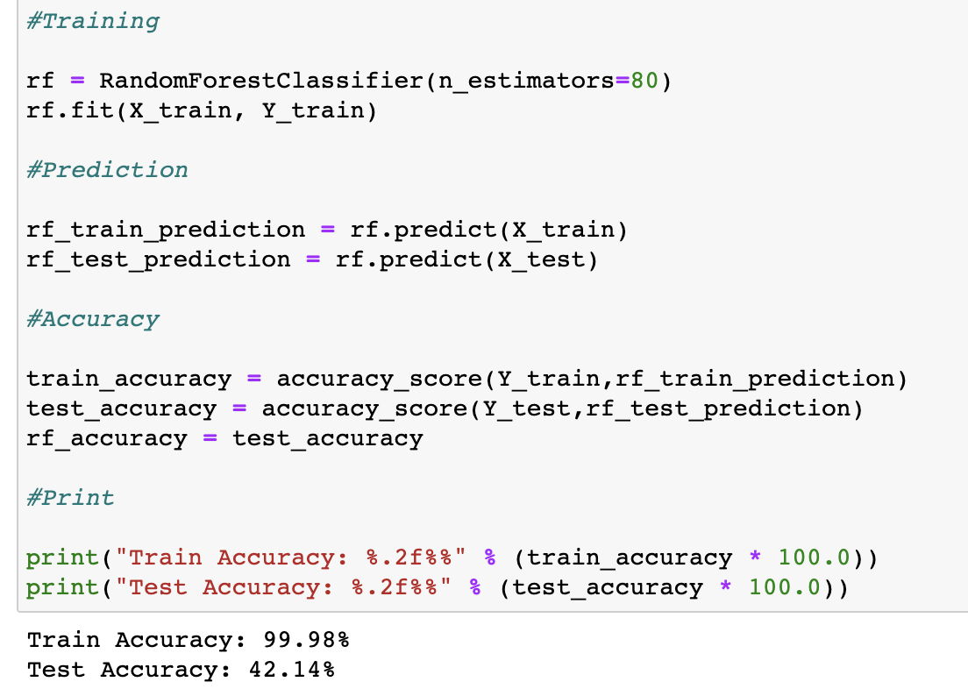
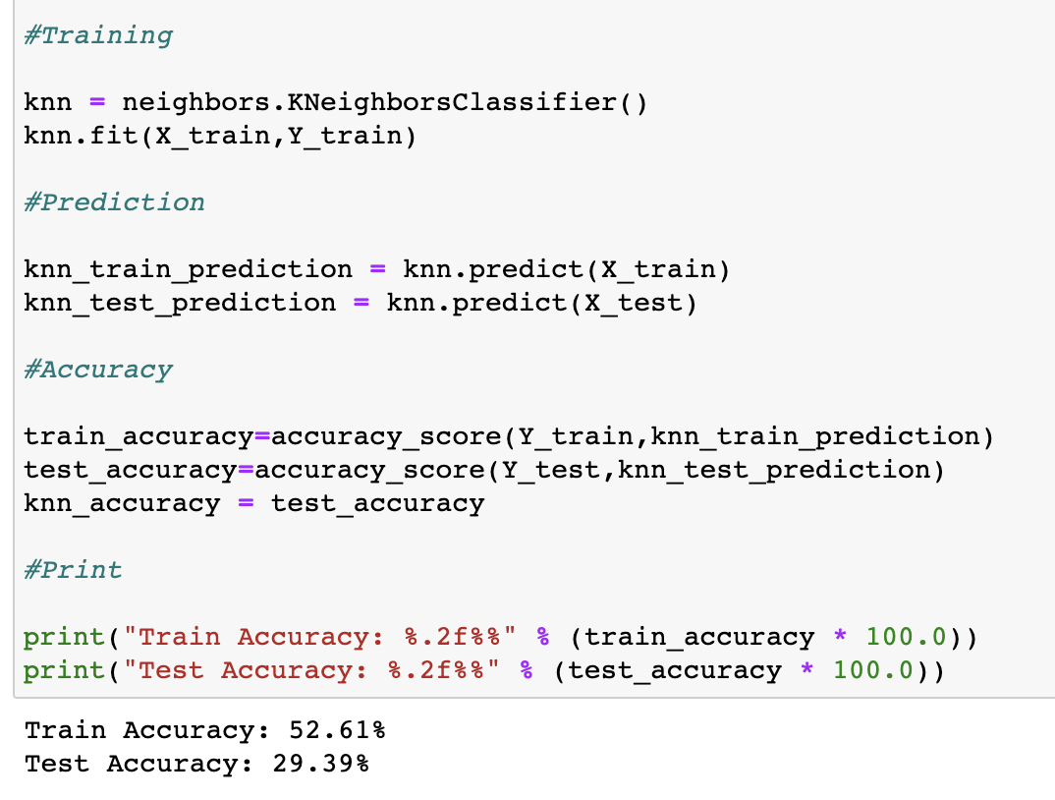
Fitting the Model – Algorithms (7/8)
Random Forest
K-NN

Slide 12
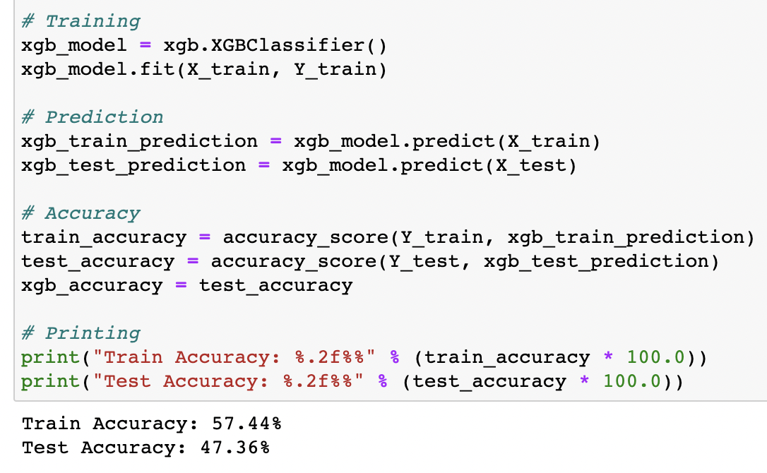
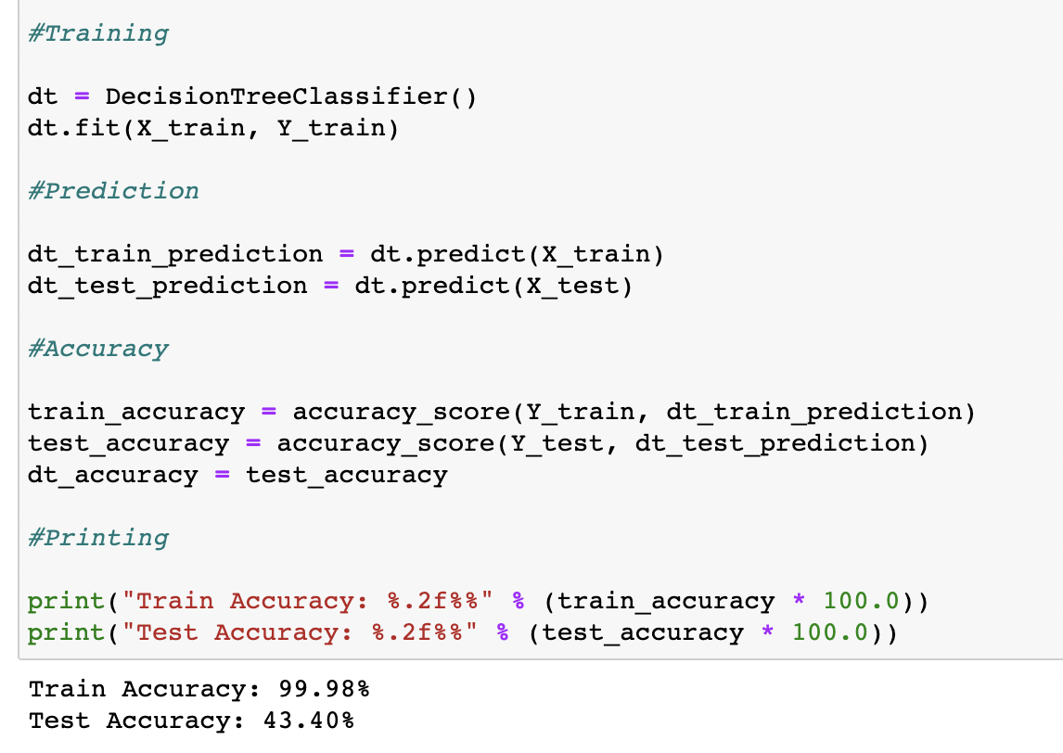
Fitting the Model - Algorithms (8/8)
XG Boost
Decision Tree

Slide 13
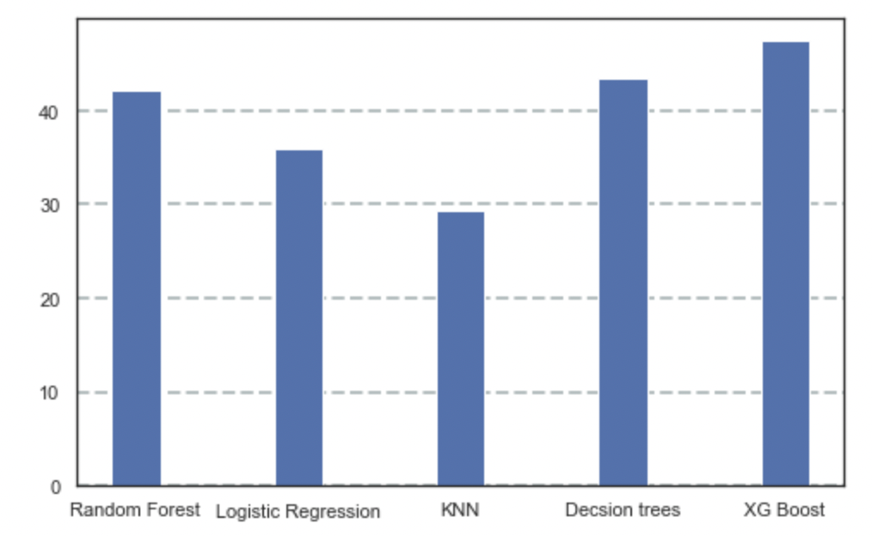
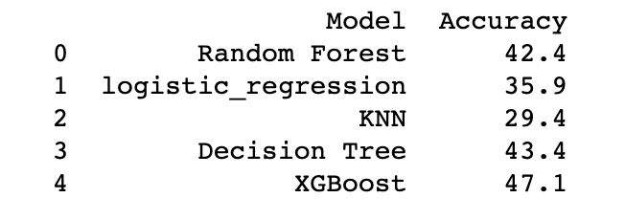
Conclusion
After running algorithms on different combinations of data, the best combination was “Data with Top 5 Hotel_cluster”
The best algorithm based on accuracy is “XG Boost”
*
*
*The accuracy for logistic regression and Knn is the lowest on train and test as it is used for binary classification problems however the data used has more than 2 categories.
Based on the above accuracies, it can be concluded that the current models may not be performing well on the given data.
It could also be helpful to consider alternative modeling techniques or to collect additional data to improve the accuracy of the models.

Slide 14
Thank You

Slide 15
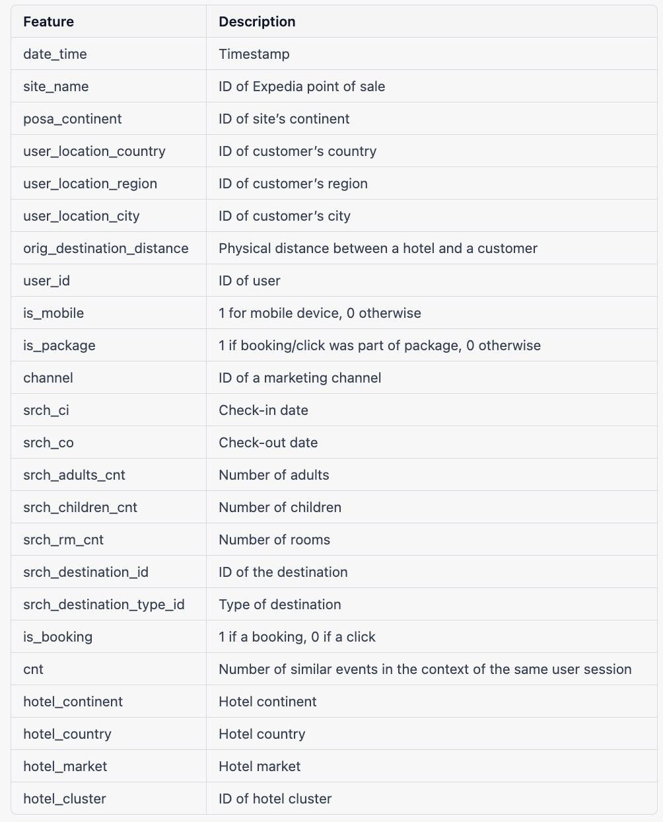
Annexure – List of Variables

Slide 16
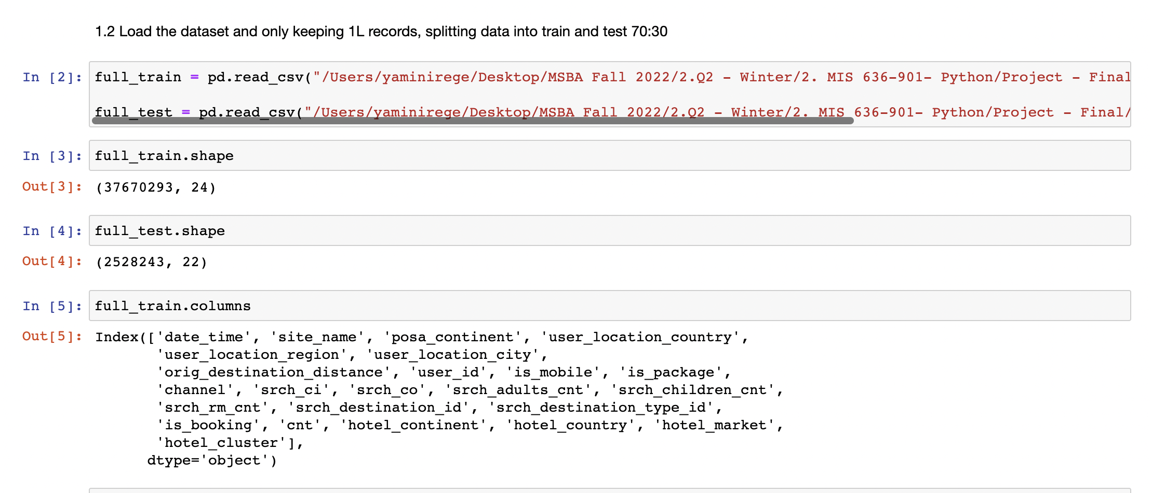
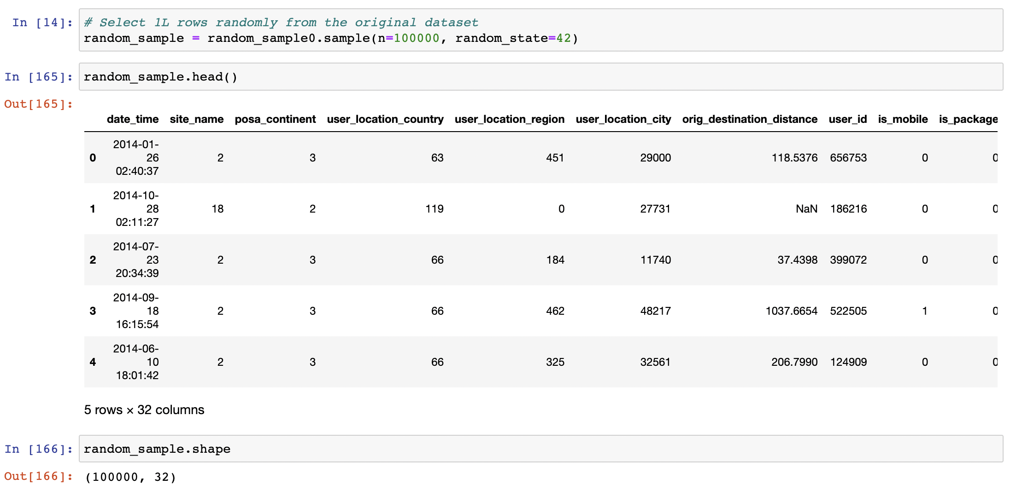
Annexure – Snippet of Code
Sr.No | Data | Accuracy
 |  | RF | LR | Knn | DT | XG Boost
1 | Without Scaling the entire data | 10.0 | 3.7 | 8.3 | 7.9 | -
2 | With Scaling the entire data | 9.9 | 6.0 | 3.3 | 8.1 | -
3 | Without Scaling, filtering top 5 clusters | 42.2 | 34.0 | 42.4 | 43.1 | -
4 | With Scaling, filtering top 5 clusters | 42.4 | 35.9 | 29.4 | 43.3 | 47.1
5 | With Scaling, filtering top 5 clusters, & year and monthwise split of train and test | 36.6 | 35.9 | 28.5 | 28.4 | -
6 | With Scaling, filtering top 10 clusters | 31.8 | 23.1 | 17.6 | 30.6 | 35.8
7 | With Scaling, filtering top 5 clusters + applying PCA | 35.7 | 35.6 | 30.6 | 27.9 | -

Slide 17
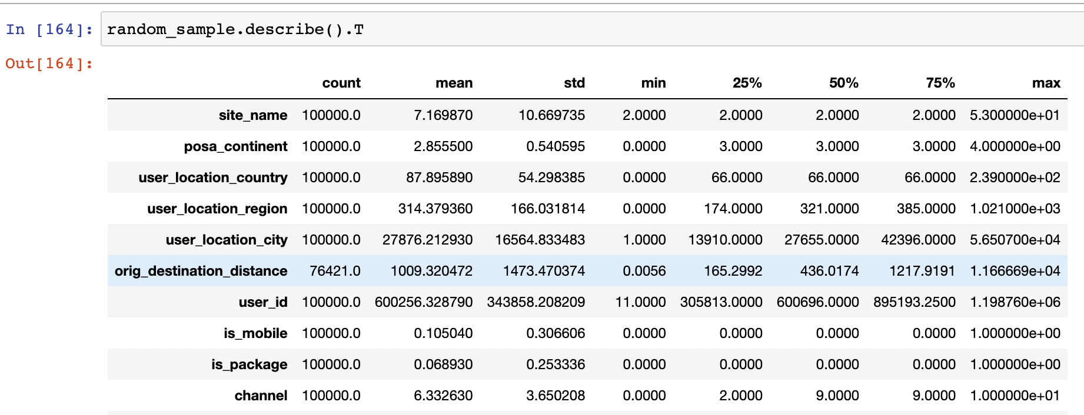
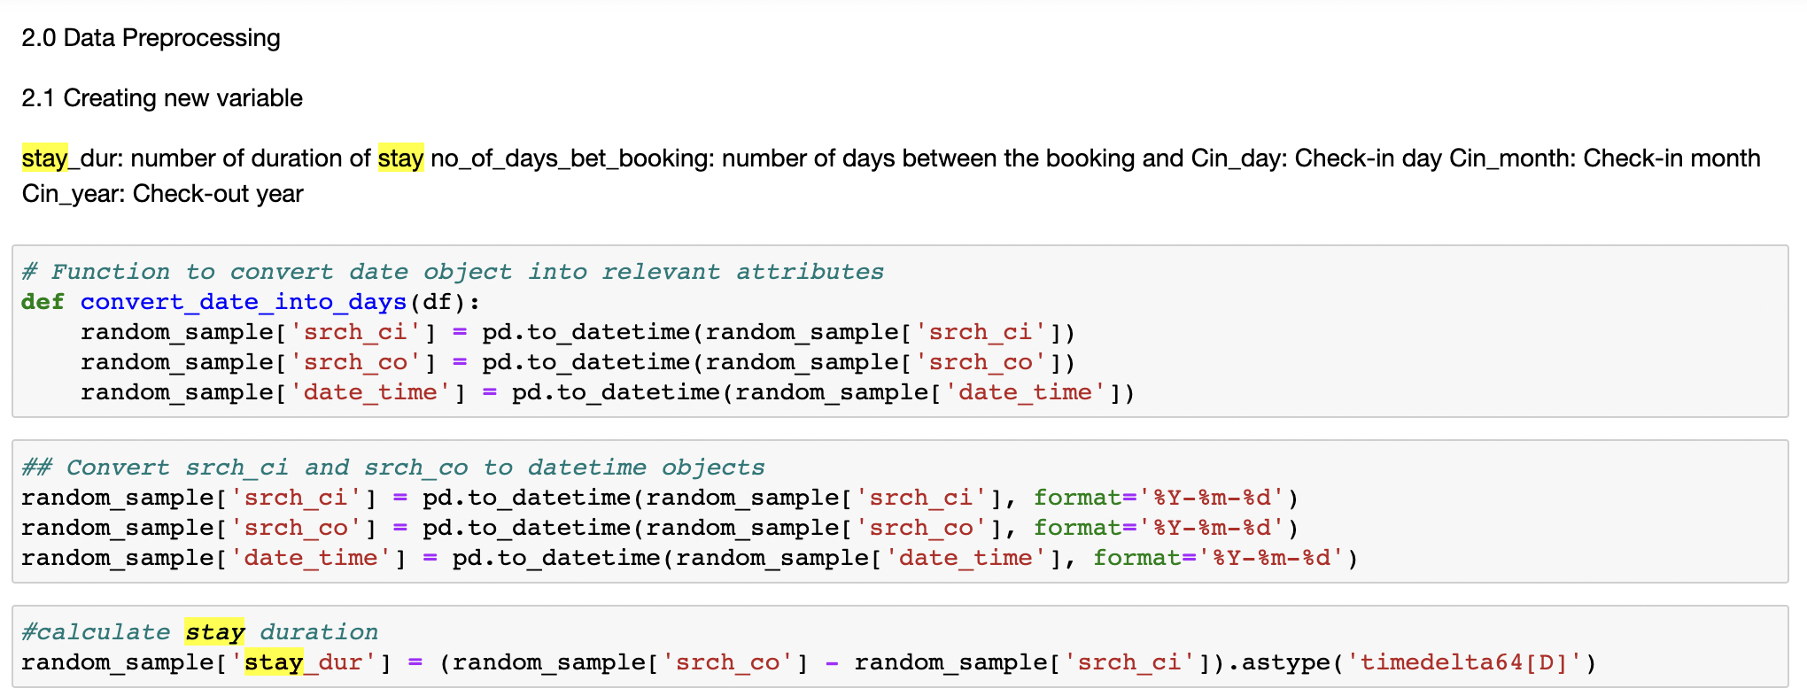
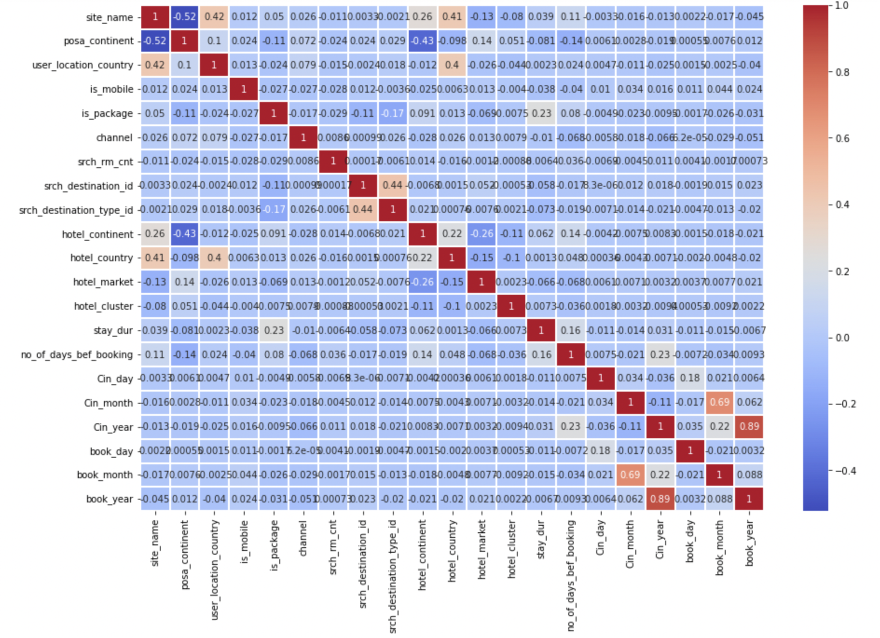
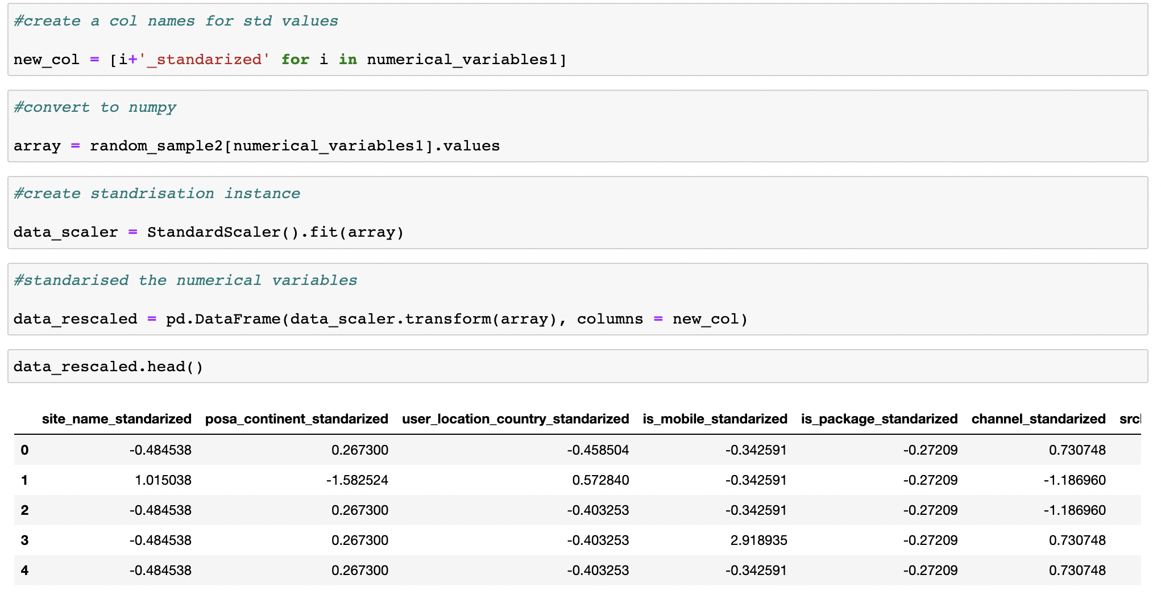
Annexure – Snippet of Code

